Slide 2
CSS Tricks to Win at Life 🚀
Week 7

Slide 3
How can we…
Make our designs more interesting?
Give them more personality?
Make them stand out?

Slide 4
New in our toolbox 🛠
Shadows
Border tricks
Rounded corners
Gradients
If time: filters and variables

Slide 5
Shadows!

Slide 6
The Web is a flat surface :(
With shadows, we can create an illusion of depth to our designs.
Depth = Hierarchy!

Slide 7
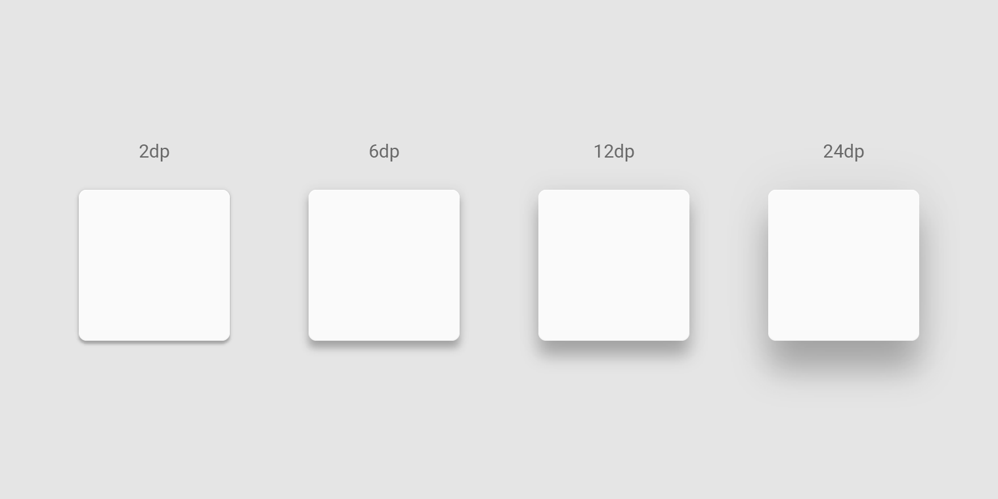
Shadows and depth

Slide 8
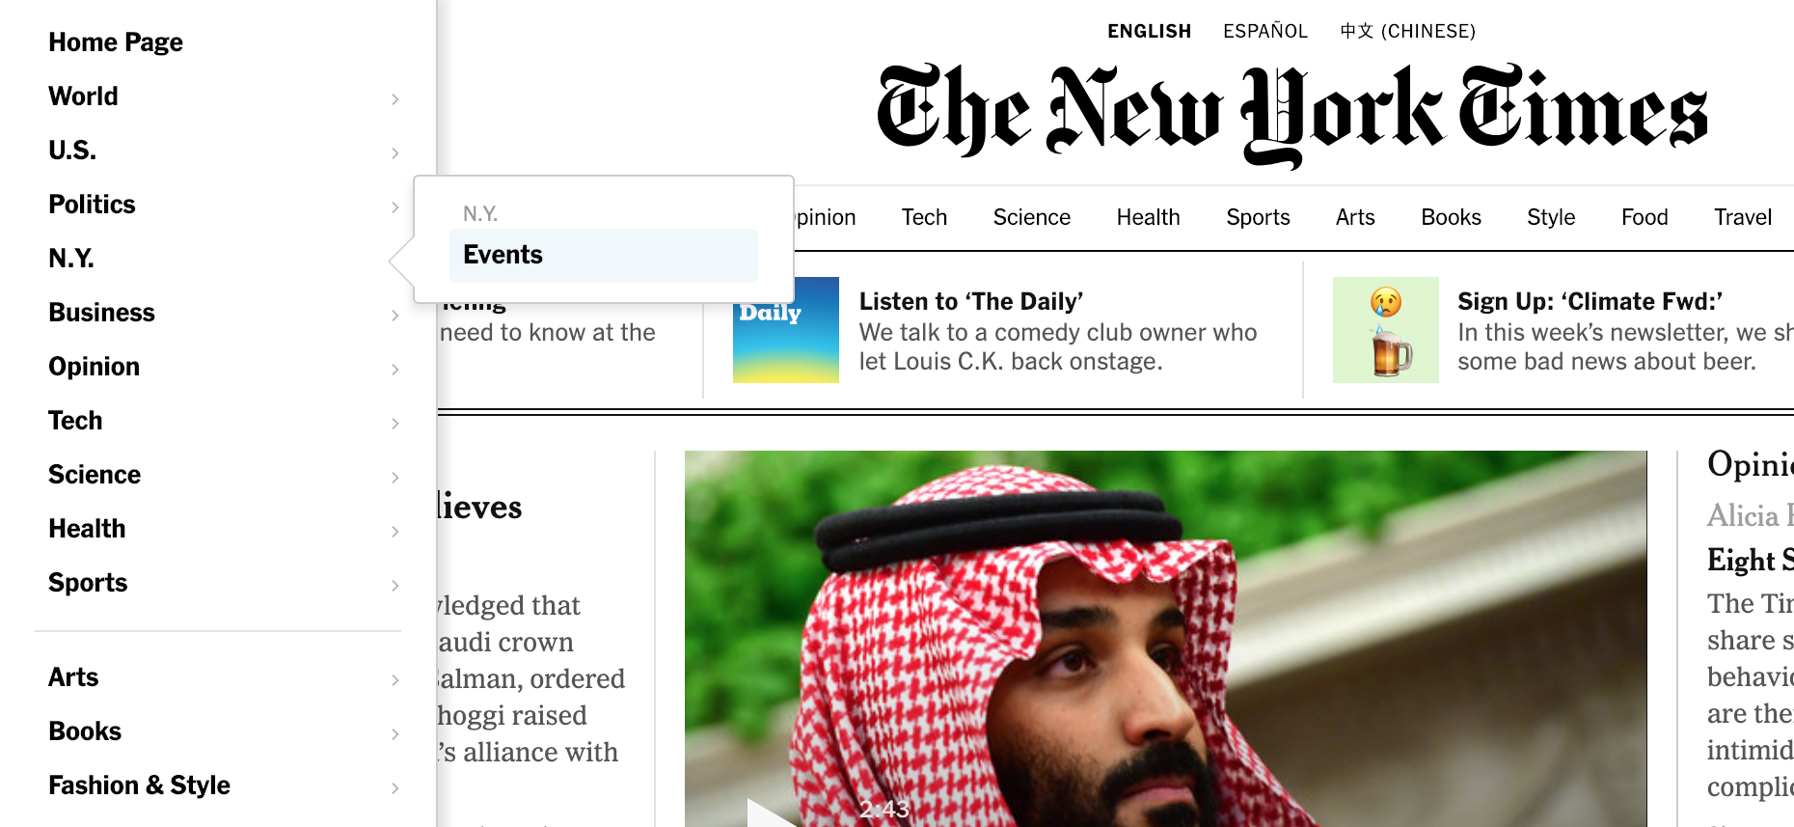
Shadows @ NYTimes

Slide 9
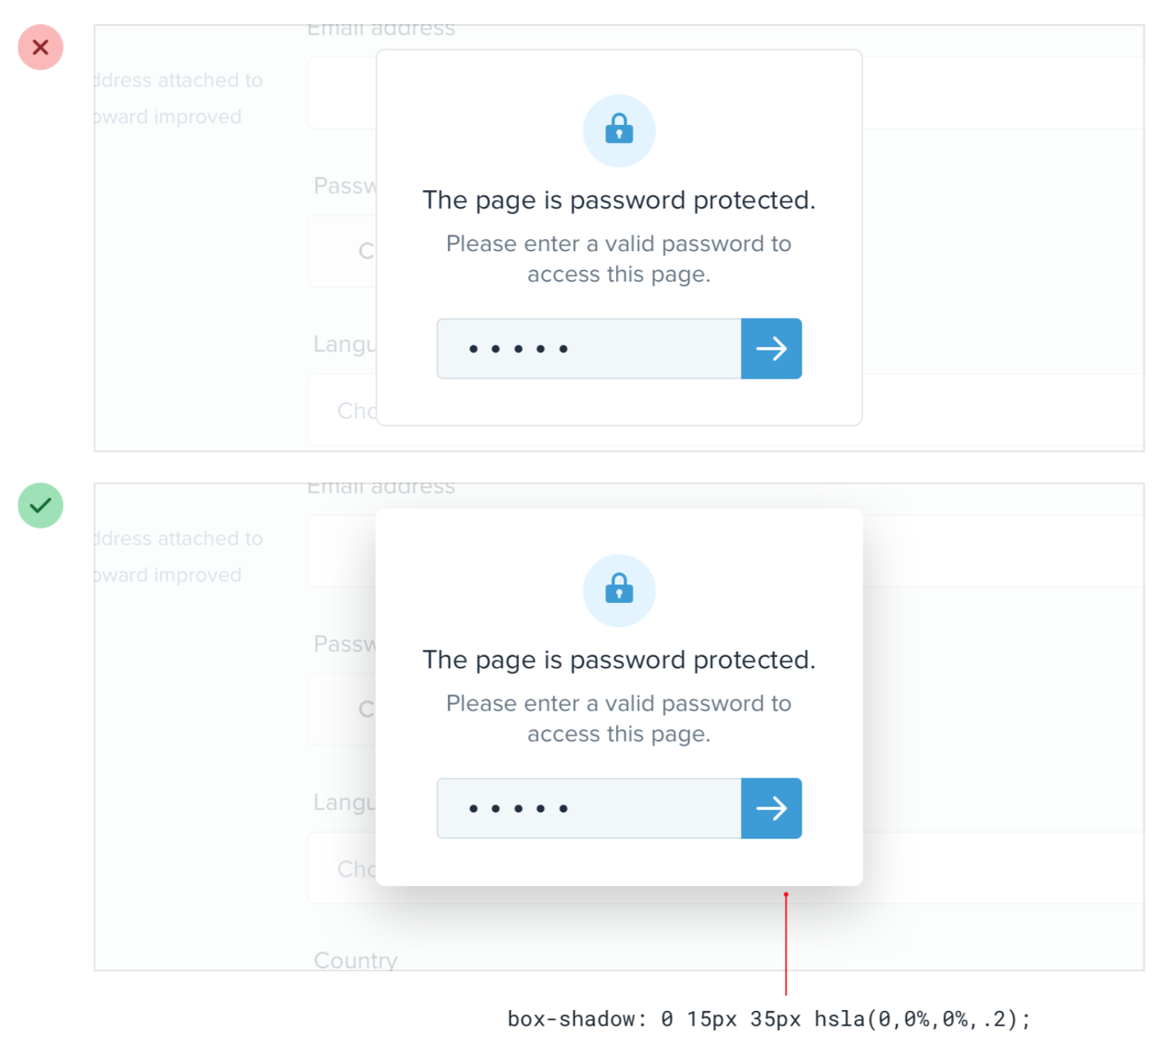
Shadows create depth [source: Refactoring UI]

Slide 10
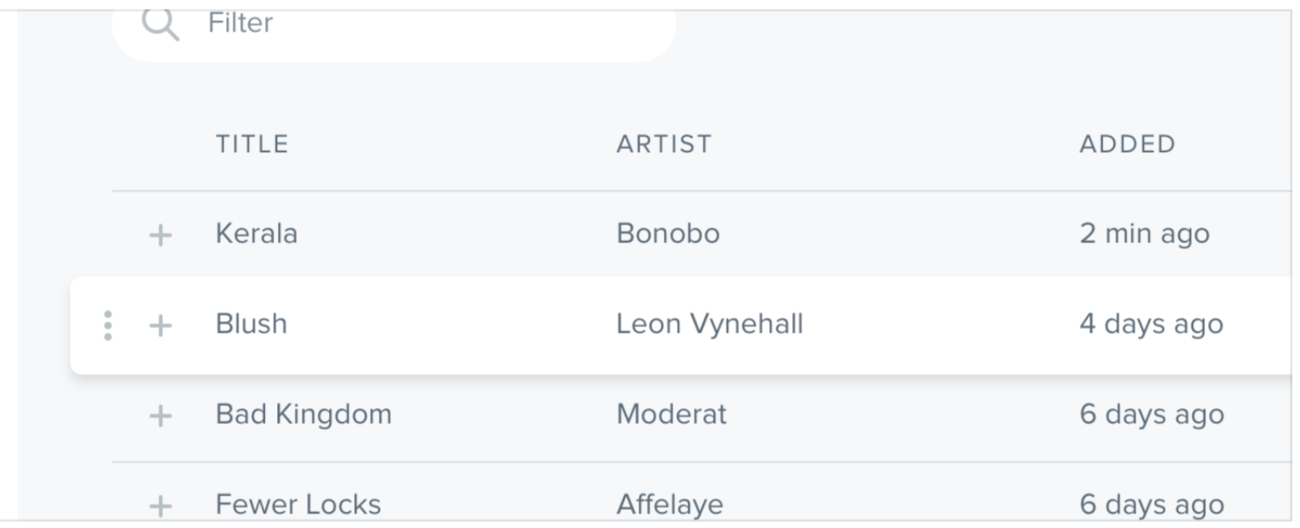

Shadows create depth, part 2 [source: Refactoring UI]

Slide 11
Shadows in CSS
box-shadow: 3px 5px 12px 4px black;
box-shadow: 0 4px 12px -2px rgba(0, 0, 0, .3);

Slide 12
Shadows in CSS
box-shadow: x offset y offset blur spread color;
box-shadow: Vertical offset
Horiz. Offset
How blurry is it?
How big is it?
Color;

Slide 13

CSS box-shadow
.my-box {
background-color: #7BBAFF;
height: 100px;
width: 100px;
/* Blurry shadow offset bottom right */
box-shadow: 6px 10px 8px 0 grey;
}

Slide 14

CSS box-shadow
.my-box {
background-color: #7BBAFF;
height: 100px;
width: 100px;
/* Blurry shadow centered */
box-shadow: 0 0 25px 0
rgba(0, 0, 0, 0.7);
}

Slide 15
~ Shadow Demo ~

Slide 16
Border tricks

Slide 17
Borders don’t always have to be on all sides.
We can use borders to and
accents and a pop of color.

Slide 18

Accent borders [Refactoring UI]

Slide 19

Accent borders [Refactoring UI]

Slide 20
Accent borders
border-bottom: 3px solid red;
border-bottom: thickness style color;
box-shadow: 0 4px 12px -2px rgba(0, 0, 0, .3);

Slide 21
~ Let’s add some borders 🎉 ~

Slide 22
Rounded corners

Slide 23
Rounded corners feel friendly, animated, fun.
Sharp corners feel classy, formal, professional.
Most corners are 2px - 8px curved.

Slide 24

Border-radius [Refactoring UI]

Slide 25

Border-radius [Refactoring UI]

Slide 26

Border-radius [Refactoring UI]

Slide 27
Curved corners
// uniform in all 4 corners
border-radius: 4px;
// different curves in 4 corners
border-top-right-radius: 4px;
...etc.

Slide 28
CSS border-radius
.my-box {
background-color: #7BBAFF;
height: 100px;
width: 100px;
/* border radius */
border-radius: 6px;
}

Slide 29
CSS border-radius
.my-box {
background-color: #7BBAFF;
height: 100px;
width: 100px;
/* border radius */
border-radius: 30%;
}

Slide 30
~ Let’s curve some corners 👀 ~

Slide 31

Gradients!

Slide 32
Gradient
Image consisting of a smooth transition between two or more colors in a certain direction

Slide 33
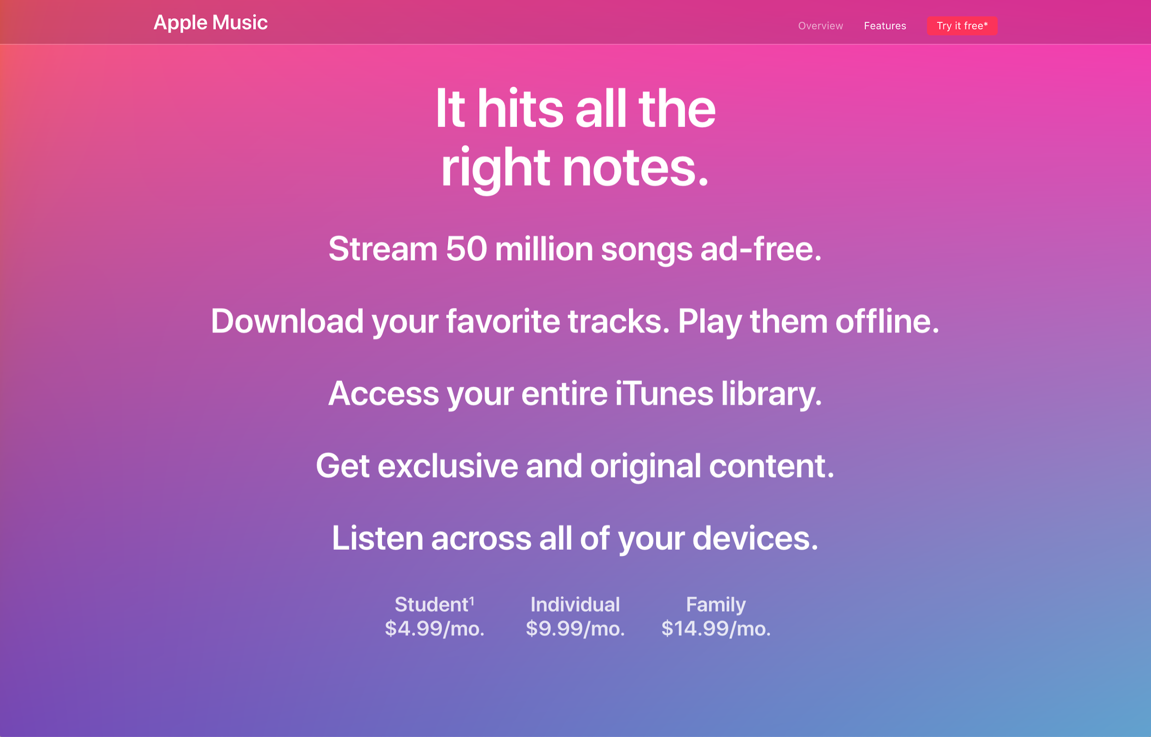
Gradients @ Apple Music

Slide 34

Gradients @ The Verge

Slide 35


Types of gradients
Linear gradient
Radial gradient

Slide 36


Linear gradients
Linear gradient
Linear gradient with stops

Slide 37
CSS Linear Gradient
background: linear-gradient(direction,
color stop, color stop, ...);

Slide 38
CSS Linear Gradient
background: linear-gradient(direction,
color stop, color stop, ...);
background: linear-gradient(to right, red,
blue);
background: linear-gradient(60deg,
#eee 20%, #bbb 60%, #456 100%);

Slide 39

linear-gradient
#fancy-box {
height: 100px;
width: 100px;
/* Simple gradient */
background: linear-gradient(to right,
yellow, red);
}

Slide 40

linear-gradient at an angle
#fancy-box {
height: 100px;
width: 100px;
/* Gradient with stops */
background: linear-gradient(-45deg,
pink 50%, blue 100%);
}

Slide 41
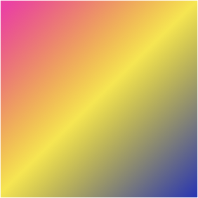
linear-gradient with 3 colors
#fancy-box {
height: 100px;
width: 100px;
/* Multi-color gradient */
background: linear-gradient(-45deg,
pink 0%, yellow 50%, blue 100%);
}

Slide 42
~ Very fancy gradient demo 🎺 ~

Slide 43
CSS Filters & CSS Variables
(a brief look)

Slide 44
github.com/webdesigndecal <- the lyrics page link from today!

